Slide 1
Basic Concepts
Source:
Radu Ionescu, Prof. PhD. raducu.ionescu@gmail.com Faculty of Mathematics and Computer Science University of Bucharest

Slide 2
Learning paradigms
Standard learning paradigms:
Supervised learning
Unsupervised learning
Semi-supervised learning
Reinforcement learning
Non-standard paradigms:
Active learning
Transfer learning
Transductive learning

Slide 3
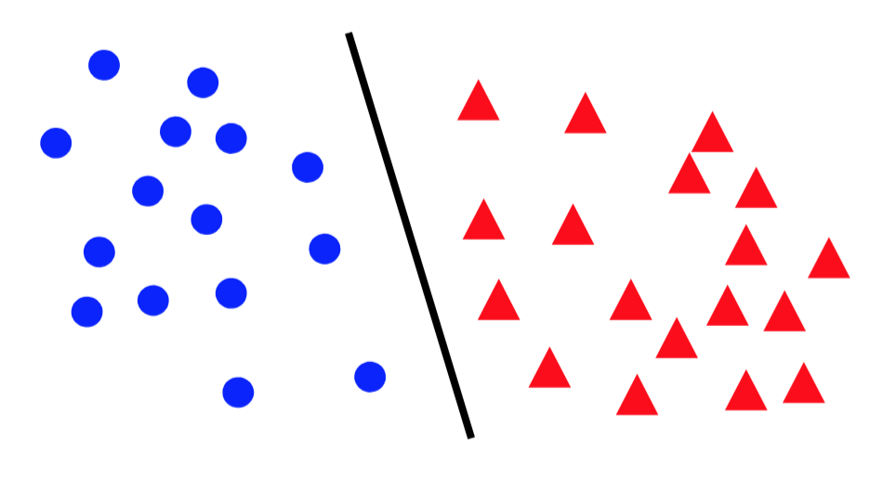
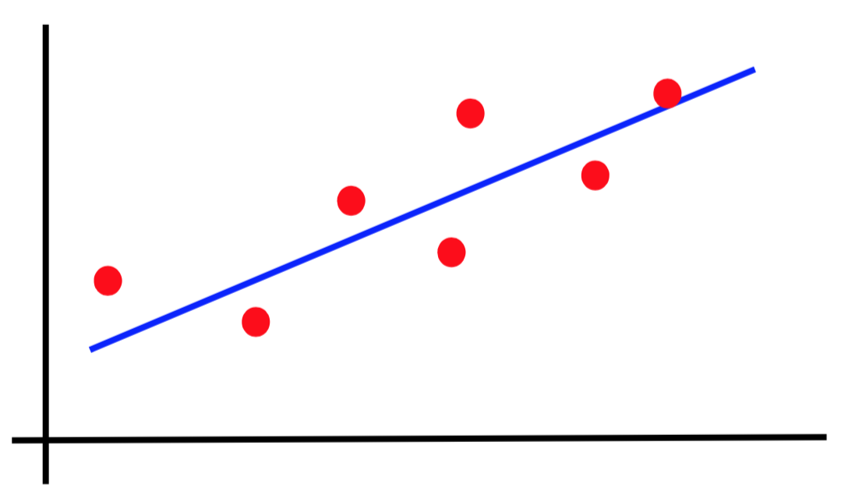
Canonical forms of supervised learning problems
Classification
Regression

Slide 4
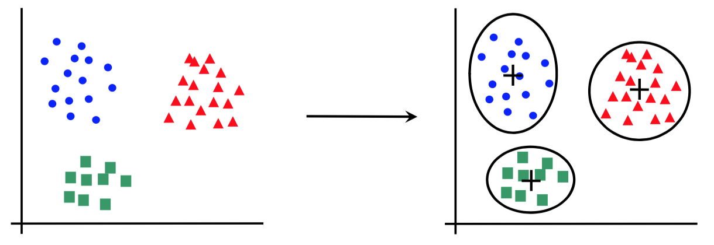
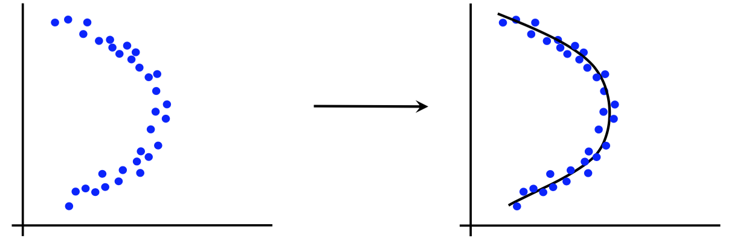
Canonical forms of unsupervised learning problems
Clustering
Dimensionality Reduction

Slide 5
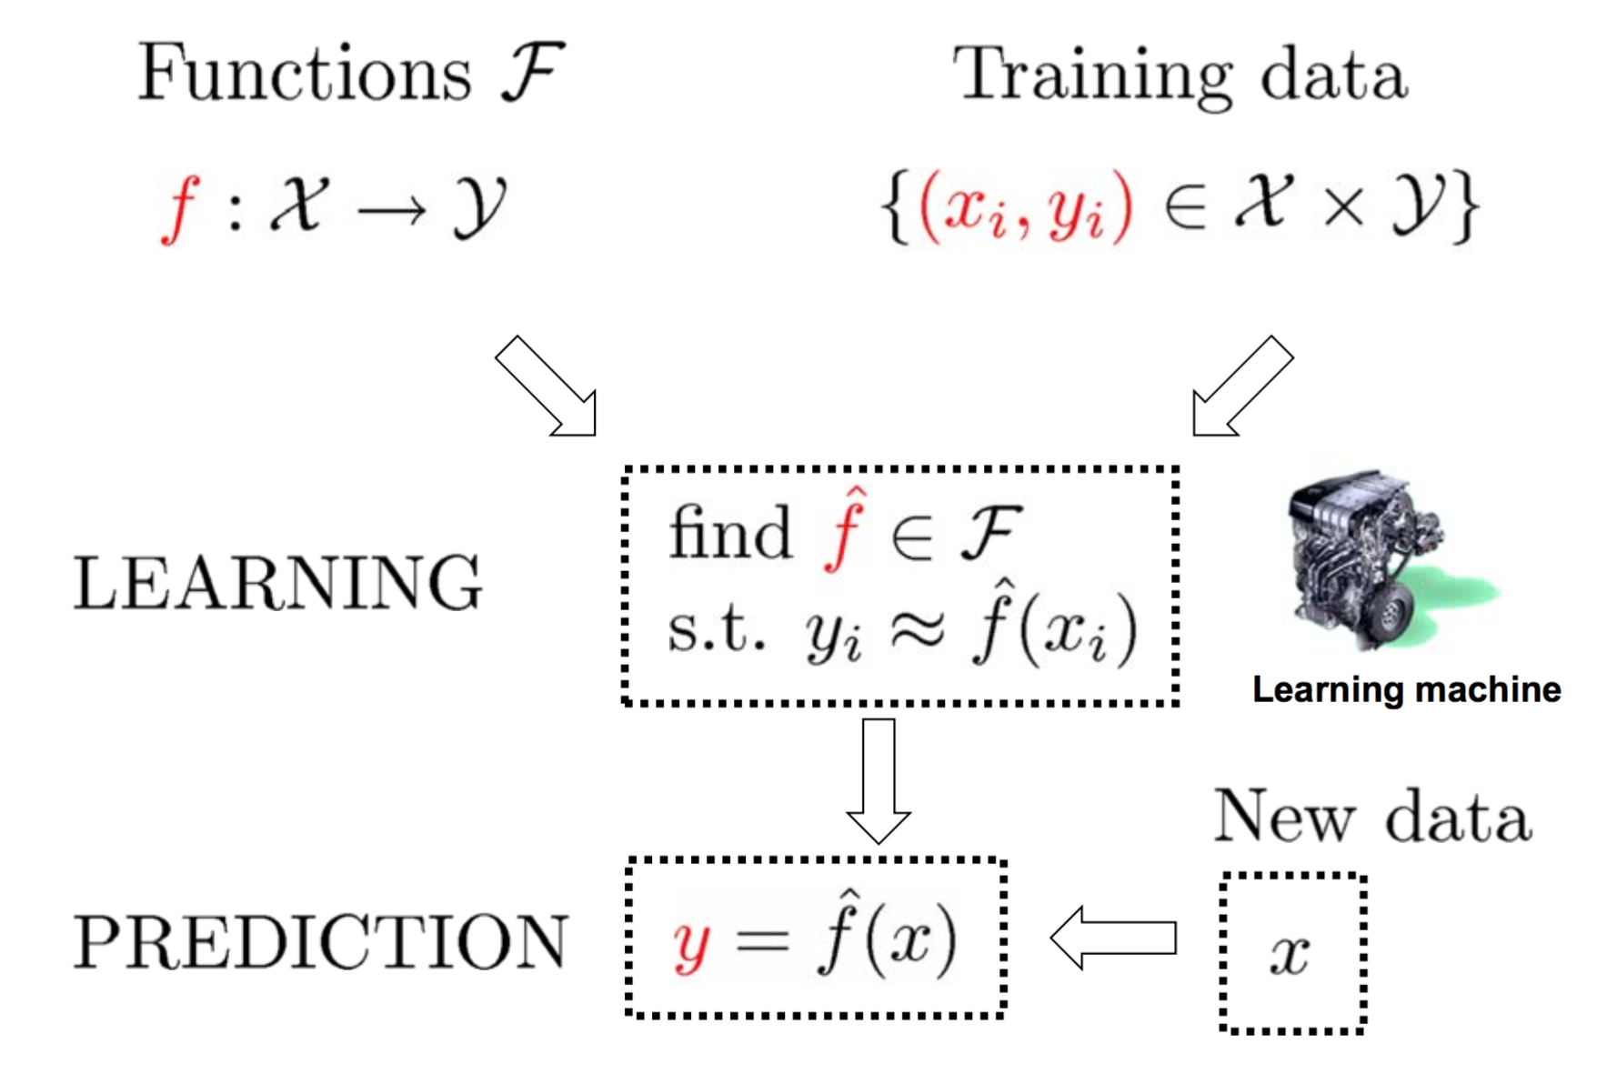
The supervised learning paradigm

Slide 6
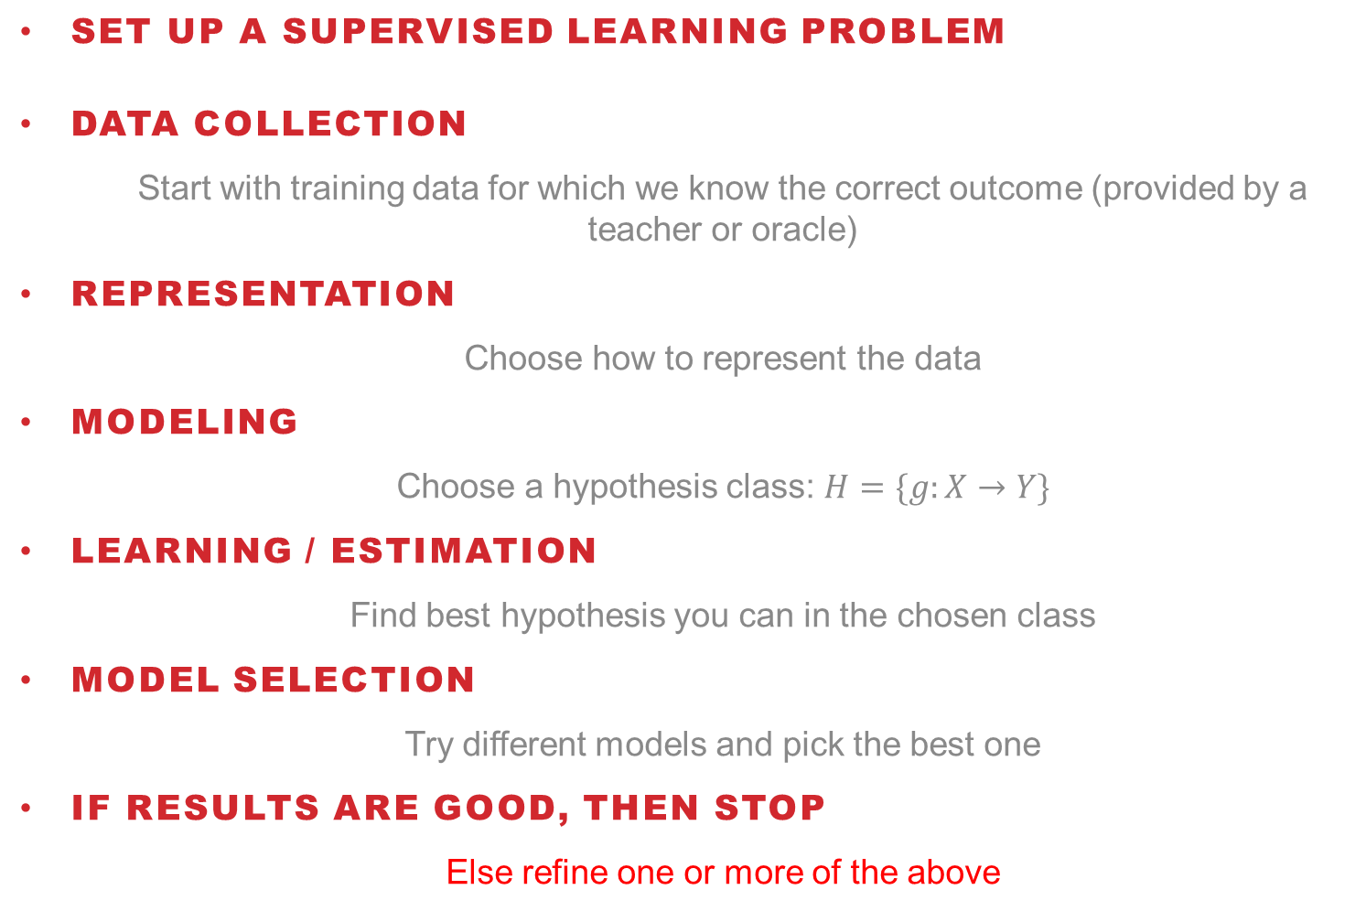
Basic Steps of Supervised Learning
Set up a supervised learning problem
Data Collection
Start with training data for which we know the correct outcome (provided by a teacher or oracle)
Representation
Choose how to represent the data
Modeling
Choose a hypothesis class: $H=\{g:X→Y\}$
Learning / Estimation
Find best hypothesis you can in the chosen class
Model Selection
Try different models and pick the best one
If results are good, then stop
Else refine one or more of the above

Slide 7
Training versus Testing
What do we want?
Good performance (low loss) on training data?
No, good performance on unseen test data!
Training Data:
{(x₁,y₁), (x₂,y₂), …, (x_{N},y_{N})}
Given to us for learning the mapping function f
Test Data:
{x₁, x₂, …, x_{M}}
Used to see if we have learnt anything 🙈

Slide 8
Loss / Error Functions
How do we measure performance?
Regression:
Mean Squared Error (MSE)
Mean Absolute Error (MAE)
Classification:
Misclassification rate
Weighted misclassification rate via a cost matrix
Binary classification:
True Positive, False Positive, True Negative, False Negative
Multi-class classification:
Confusion Matrix

Slide 9
Bias-Variance Trade-off
Bias
Systematic error that comes from the inability of the model to learn the true relationship between features and labels (underfitting)
Can be corrected by increasing the model’s complexity
Variance
Random error that comes from sensitivity to small fluctuations in the data, because the algorithm modeled noise in the training data (overfitting)
Can be corrected by adding more training samples or by decreasing the model’s complexity

Slide 10
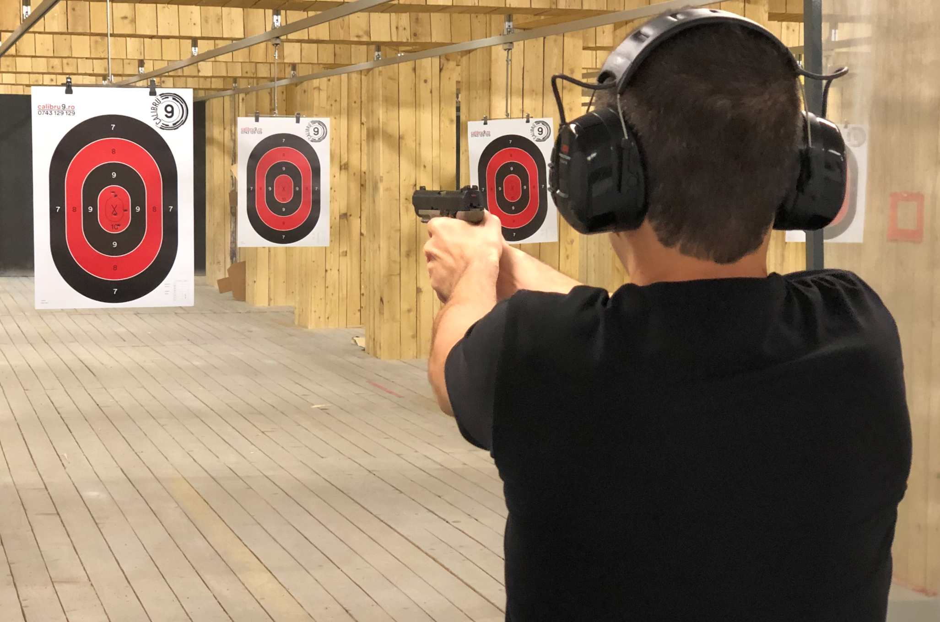
Bias-Variance Trade-off

Slide 11
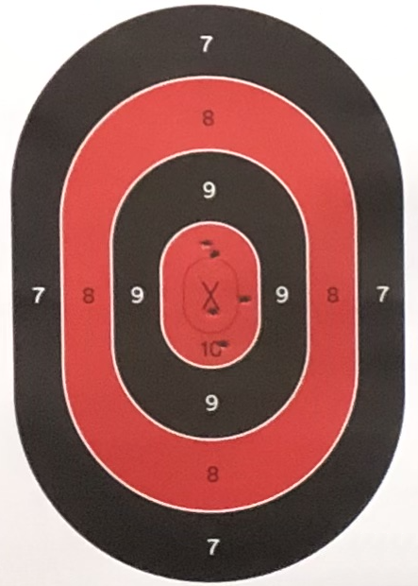
Bias-Variance Trade-off
Low Bias
High Bias
Low Variance
High Variance

Slide 12
Underfitting versus overfitting
OVERFITTING
Overfitting happens when a model learns the detail and noise in the training data to the extent that it negatively impacts the performance of the model on new data.
This means that the noise or random fluctuations in the training data is picked up and learned as concepts by the model. The problem is that these concepts do not apply to new data and negatively impact the models ability to generalize.
UNDERFITTING
Underfitting refers to a model that can neither model the training data nor generalize to new data.
An underfit machine learning model is not a suitable model and will be obvious as it will have poor performance on the training data.

Slide 13
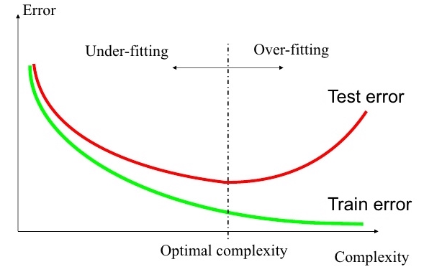
Underfitting versus overfitting
Perhaps the most important problem of learning?
All about improving generalization capacity

Slide 14
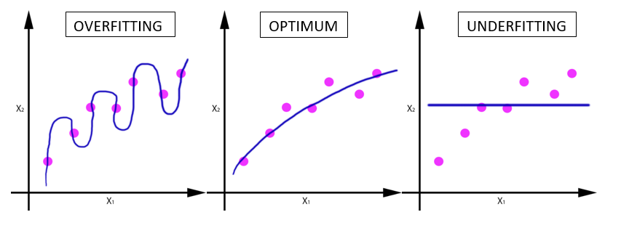
Underfitting versus overfitting
Example 1: regression task

Slide 15
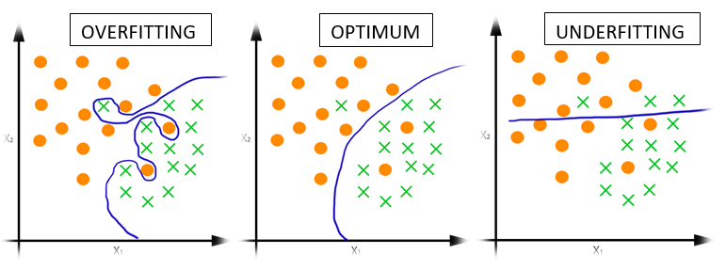
Underfitting versus overfitting
Example 2: classification task

Slide 16
Procedural View
Training Stage:
Raw data → x
(feature extraction)
Training data {(x, y)} → f
(learning)
Testing Stage:
Raw data → x
(feature extraction)
Test data x → f(x)
(apply function, evaluate error)

Slide 17
Important Concepts
Model capacity
Measure how large hypothesis class H is?
Are all functions allowed?
Overfitting
f works well on training data
Works poorly on test data
Generalization capacity
The ability to achieve low error on new test data

Slide 18
Splitting the data into
training, validation and test
In order to build a model with good generalization capacity, we have to test it on unseen data
First approach (works well when we have enough data):
50% samples for training
25% samples for validation
25% samples for test
(percentages can vary)

Slide 19
Why not just split the data into
training and test?
Repeatedly using the same split when trying different hyperparameters can “wear out” the test set:
We are overfitting in hyperparameter space!
We obtain a better error estimate by tuning the hyperparameters on a (different) validation set

Slide 20
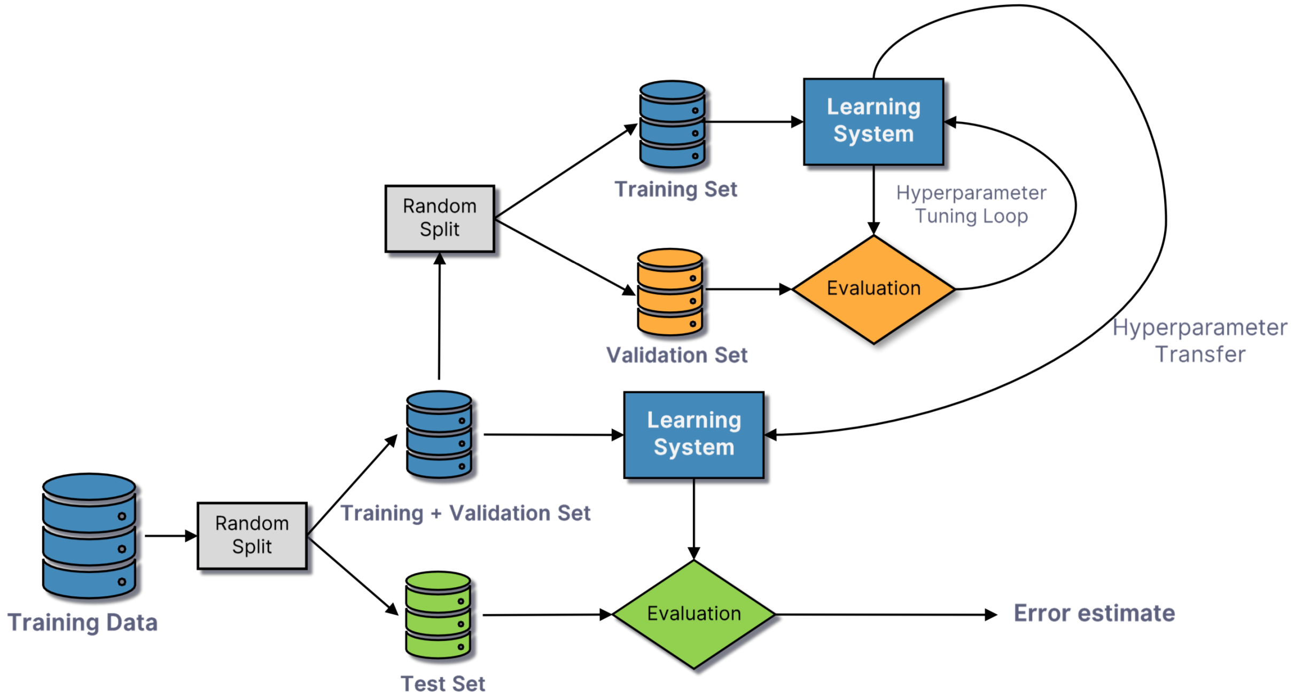
Training, validation, test

Slide 21
Cross-validation
Another approach (works well when we have limited data):
Split the data into k equal parts (folds)
Train on k-1 folds and test on the left out fold
Repeat for k times
Average the results
When the number of folds is equal to the number of samples:
Leave-one-out cross-validation

Slide 22
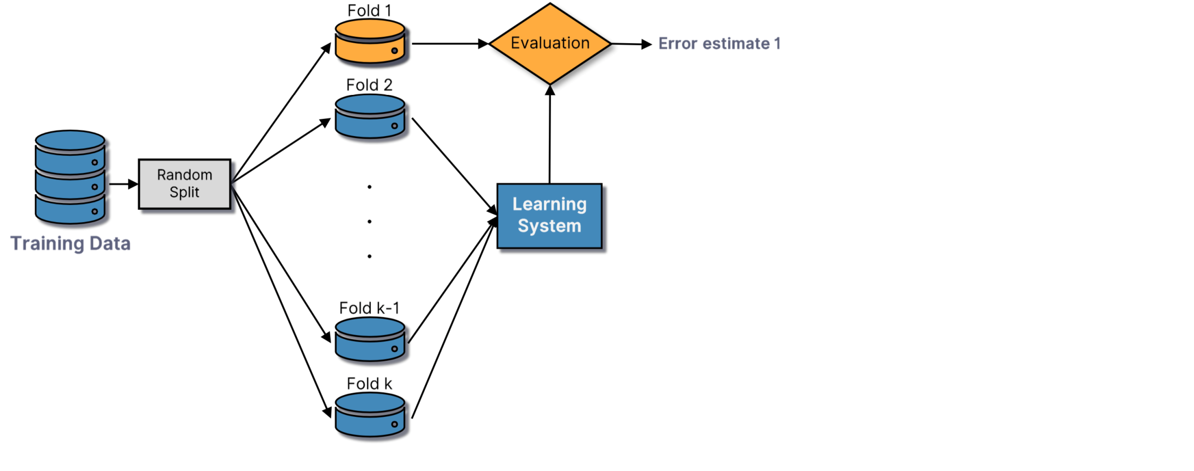
Cross-validation

Slide 23
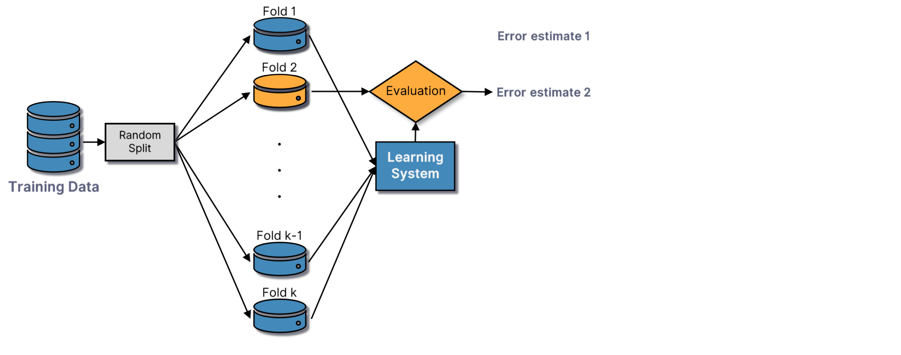
Cross-validation

Slide 24
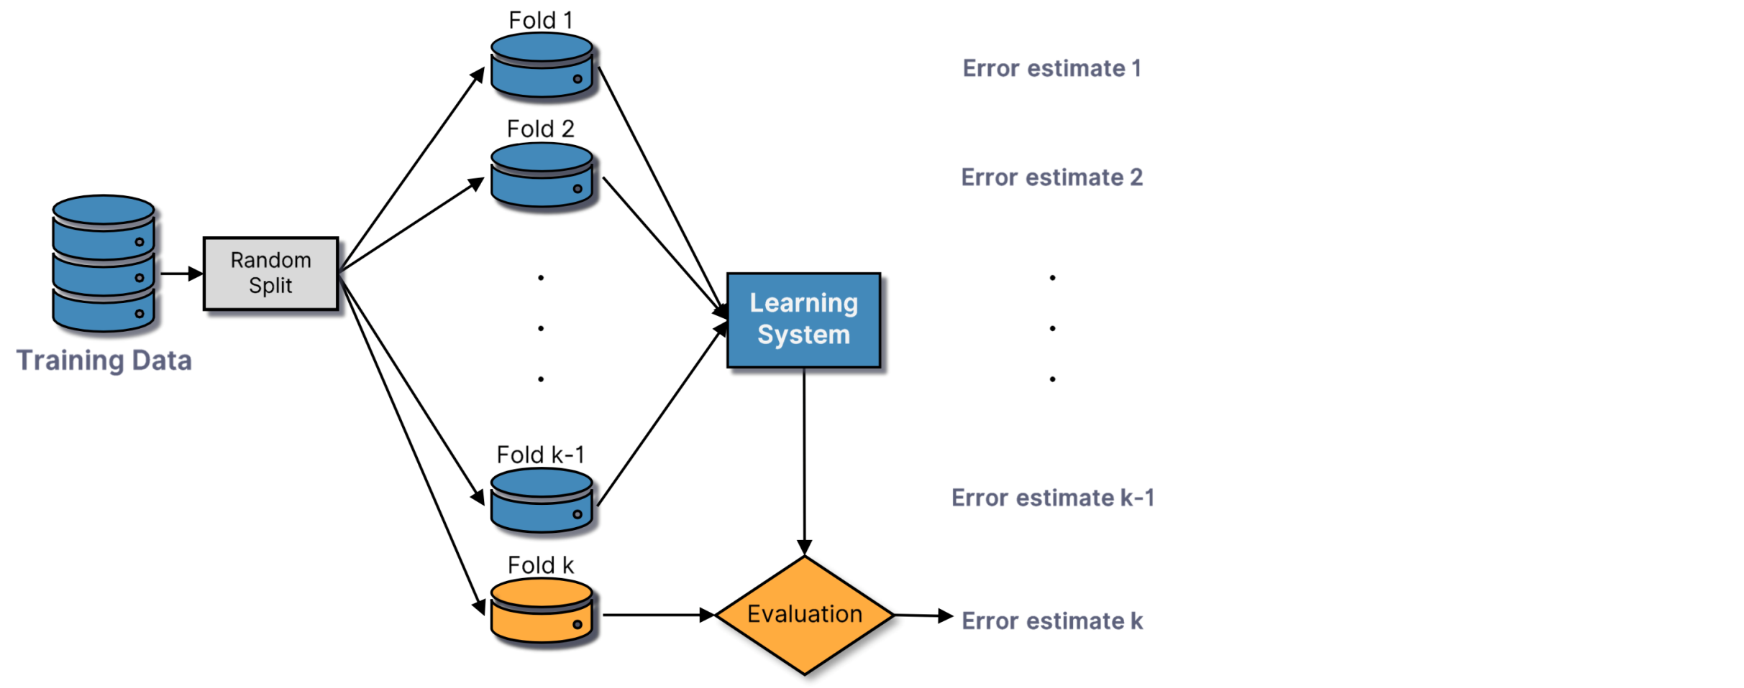
Cross-validation

Slide 25
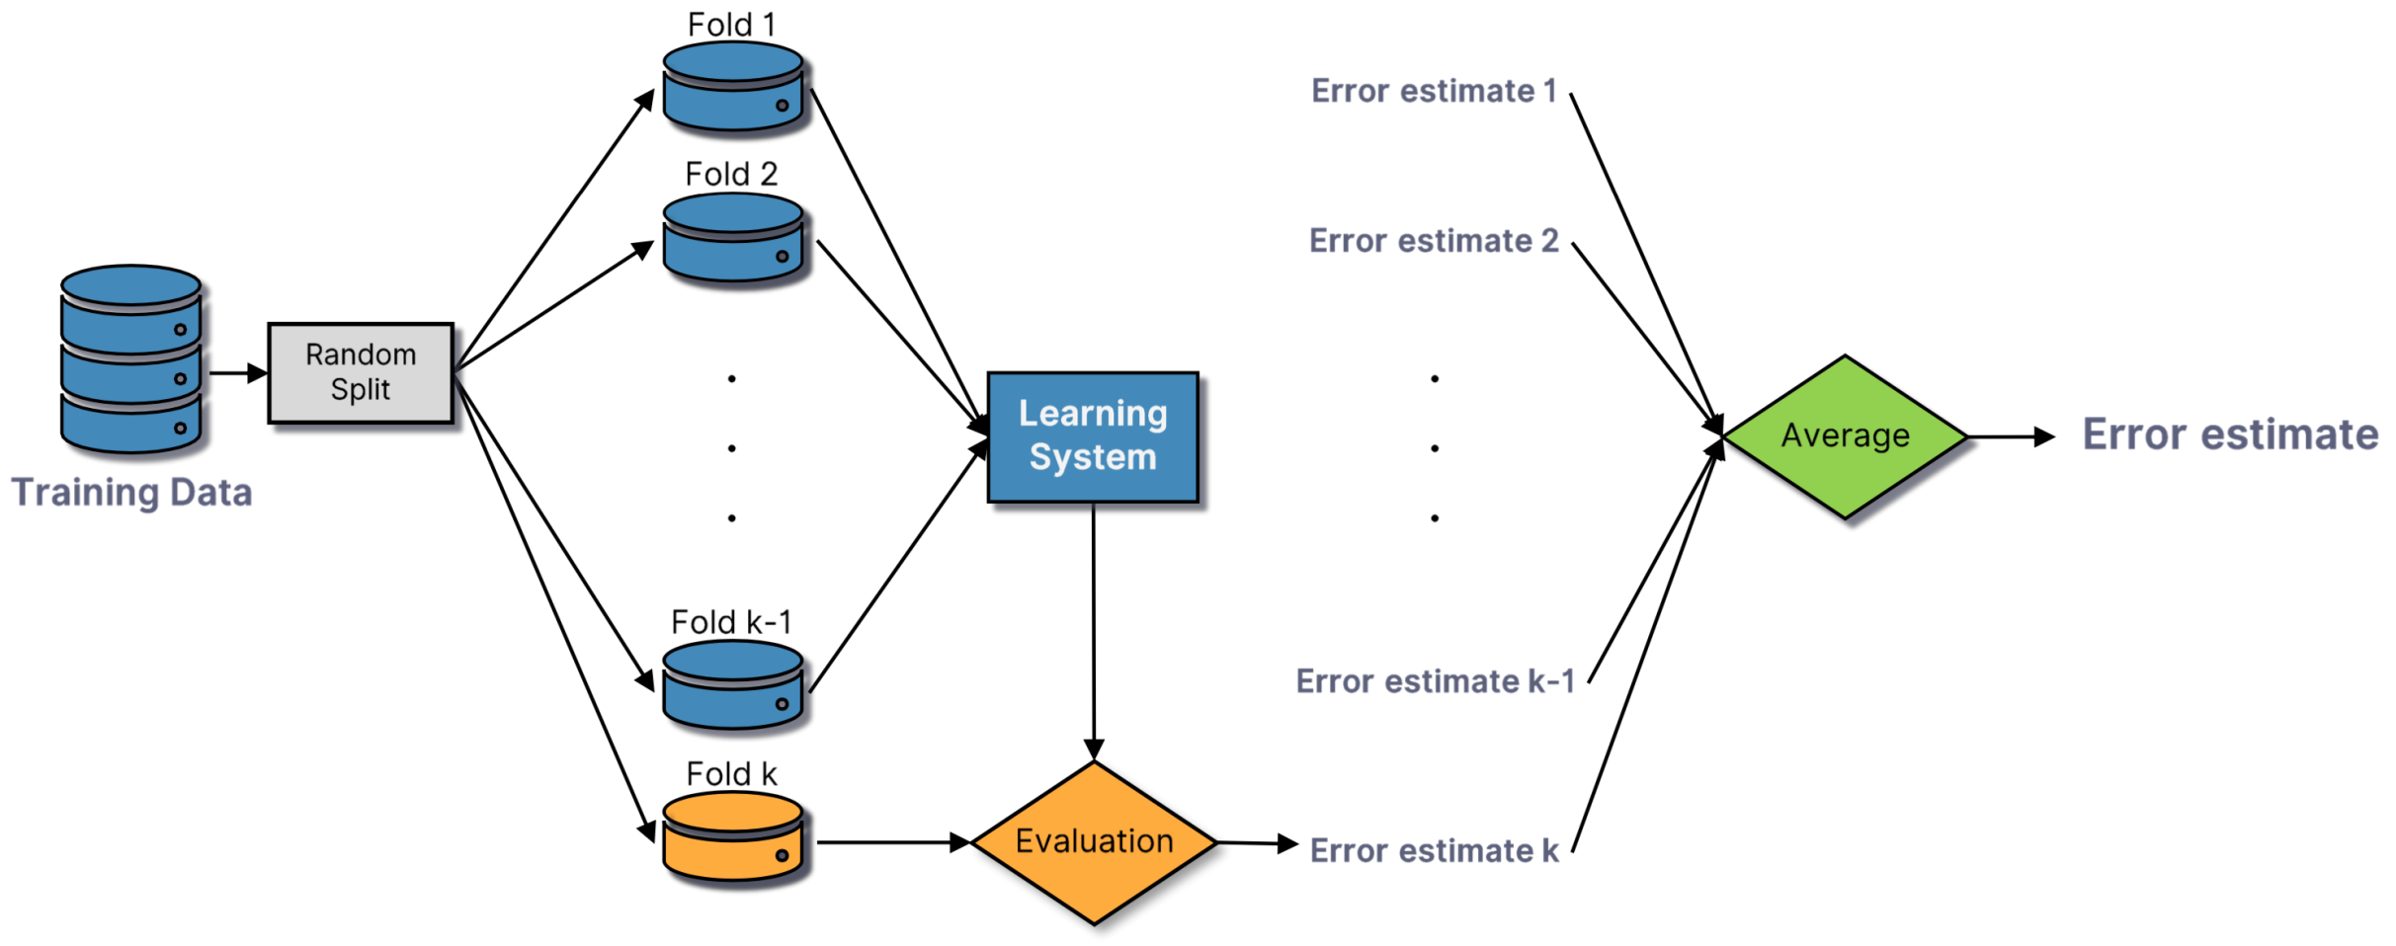
Cross-validation

Slide 26
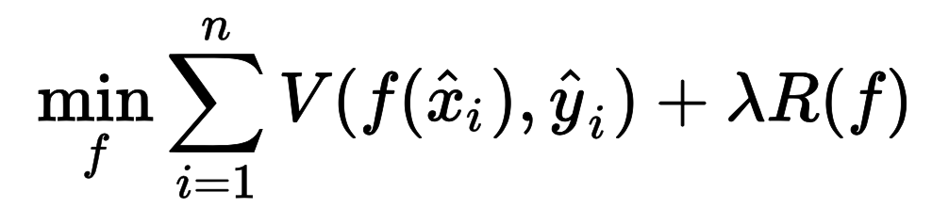
Improving generalization
Early Stopping
Stop the learning process when we notice that the validation error starts to increase
Regularization
Add a penalty term to the loss function to reduce model complexity, by imposing smoothing restrictions or a limit on the weight vector norm:

Slide 27
Performance Evaluation

Slide 28
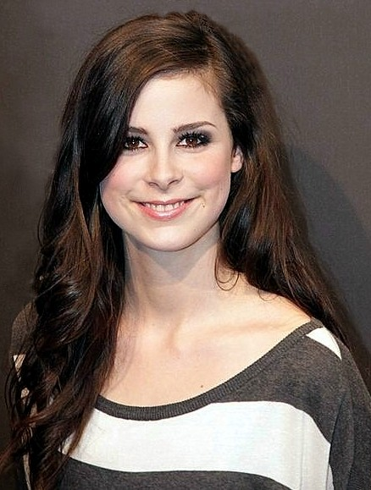
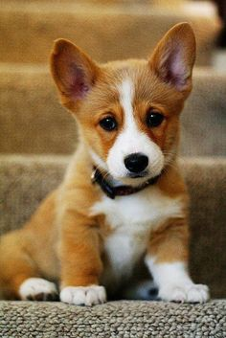

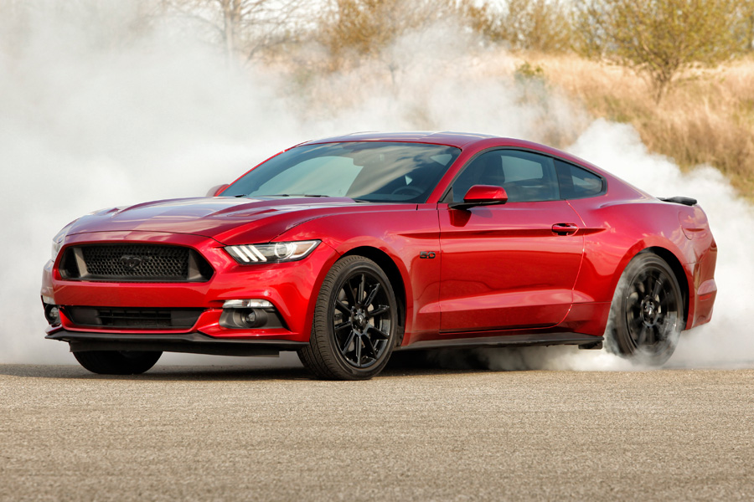
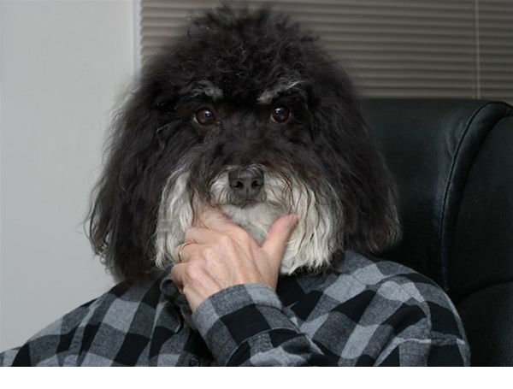
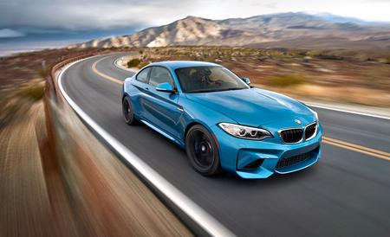
How do we evaluate an ML model?
We measure the accuracy / error on test data:
Accuracy: 4 correct out of 6 = 66.67%
Error: 2 wrong out of 6 = 33.33%
Car?
Person?
Person?
Person?
Dog?
Dog?

Slide 29
How do we evaluate an ML model?
We build the confusion matrix
Accuracy: the sum of the elements from the main diagonal divided by the sum of non-zero components (4/6)
Error: the sum of the elements outside the main diagonal divided by the sum of non-zero components (2/6)
Car?
Person?
Person?
Person?
Dog?
Dog?
Predicted Actual | Car | Dog | Person
Car | 1 | 1 | 0
Dog | 0 | 1 | 1
Person | 0 | 0 | 2

Slide 30

How do we evaluate an ML model?
Confusion matrix in the binary case
Not?
Person?
Person?
Person?
Not?
Not?
 | Predicted YES | Predicted NO
Actual YES | True Positive | False Negative
Actual NO | False Positive | True Negative

Slide 31
How do we evaluate an ML model?
Confusion matrix in the binary case
Not?
Person?
Person?
Person?
Not?
Not?
 | Predicted YES | Predicted NO
Actual YES | 2 | False Negative
Actual NO | False Positive | True Negative

Slide 32
How do we evaluate an ML model?
Confusion matrix in the binary case
Not?
Person?
Person?
Person?
Not?
Not?
 | Predicted YES | Predicted NO
Actual YES | 2 | 1
Actual NO | False Positive | True Negative

Slide 33
How do we evaluate an ML model?
Confusion matrix in the binary case
Not?
Person?
Person?
Person?
Not?
Not?
 | Predicted YES | Predicted NO
Actual YES | 2 | 1
Actual NO | 1 | True Negative

Slide 34
How do we evaluate an ML model?
Confusion matrix in the binary case
Not?
Person?
Person?
Person?
Not?
Not?
 | Predicted YES | Predicted NO
Actual YES | 2 | 1
Actual NO | 1 | 2

Slide 35
How do we evaluate an ML model?
We compute Precision and Recall
Precision = TP / (TP + FP)
= 66.67%
Recall = TP / (TP + FN)
= 66.67%
Not?
Person?
Person?
Person?
Not?
Not?
 | Predicted YES | Predicted NO
Actual YES | 2 | 1
Actual NO | 1 | 2

Slide 36
How do we evaluate an ML model?
We build the Precision-Recall curve
Person?
Not?
Person?
Not?
Person?
Not?

Slide 37
How do we evaluate an ML model?
We compute the TP Rate and the FP Rate
TPR = TP / (TP + FP)
= 66.67%
FPR = FP / (FP + TN)
= 33.33%
Not?
Person?
Person?
Person?
Not?
Not?
 | Predicted YES | Predicted NO
Actual YES | 2 | 1
Actual NO | 1 | 2

Slide 38
How do we evaluate an ML model?
ROC (Receiver Operating Characteristic) Curve
1
TPR
0
FPR
1

Slide 39
How do we evaluate an ML model?
We compute the AUC (area under the ROC curve)
1
TPR
0
FPR
1

Slide 40
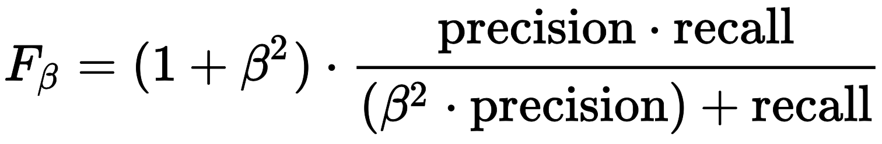
How do we evaluate an ML model?
We compute the F_{β} score
The F₁ score is the most commonly-used in practice:
Gives equal importance to precision and recall

